Slide 1
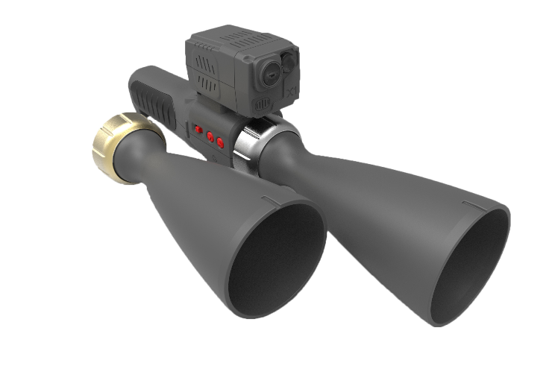
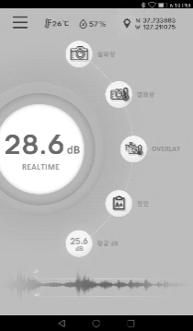
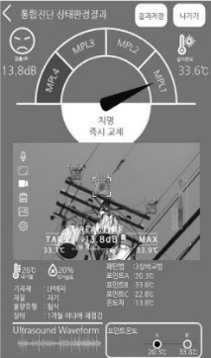
INSPECTION CASES
Experience state of the art Ultrasound and Infrared technologies Integrated into a single device

Slide 2
Kincade Fire Transmission Inspection Project
Summary
Date : 11.04 ~ 11.14 2019
Area : Geyserville, CA
A total of 411 structure were acoustically inspected 26 defects were found
Hardware
Priority Level
Defects

Slide 3
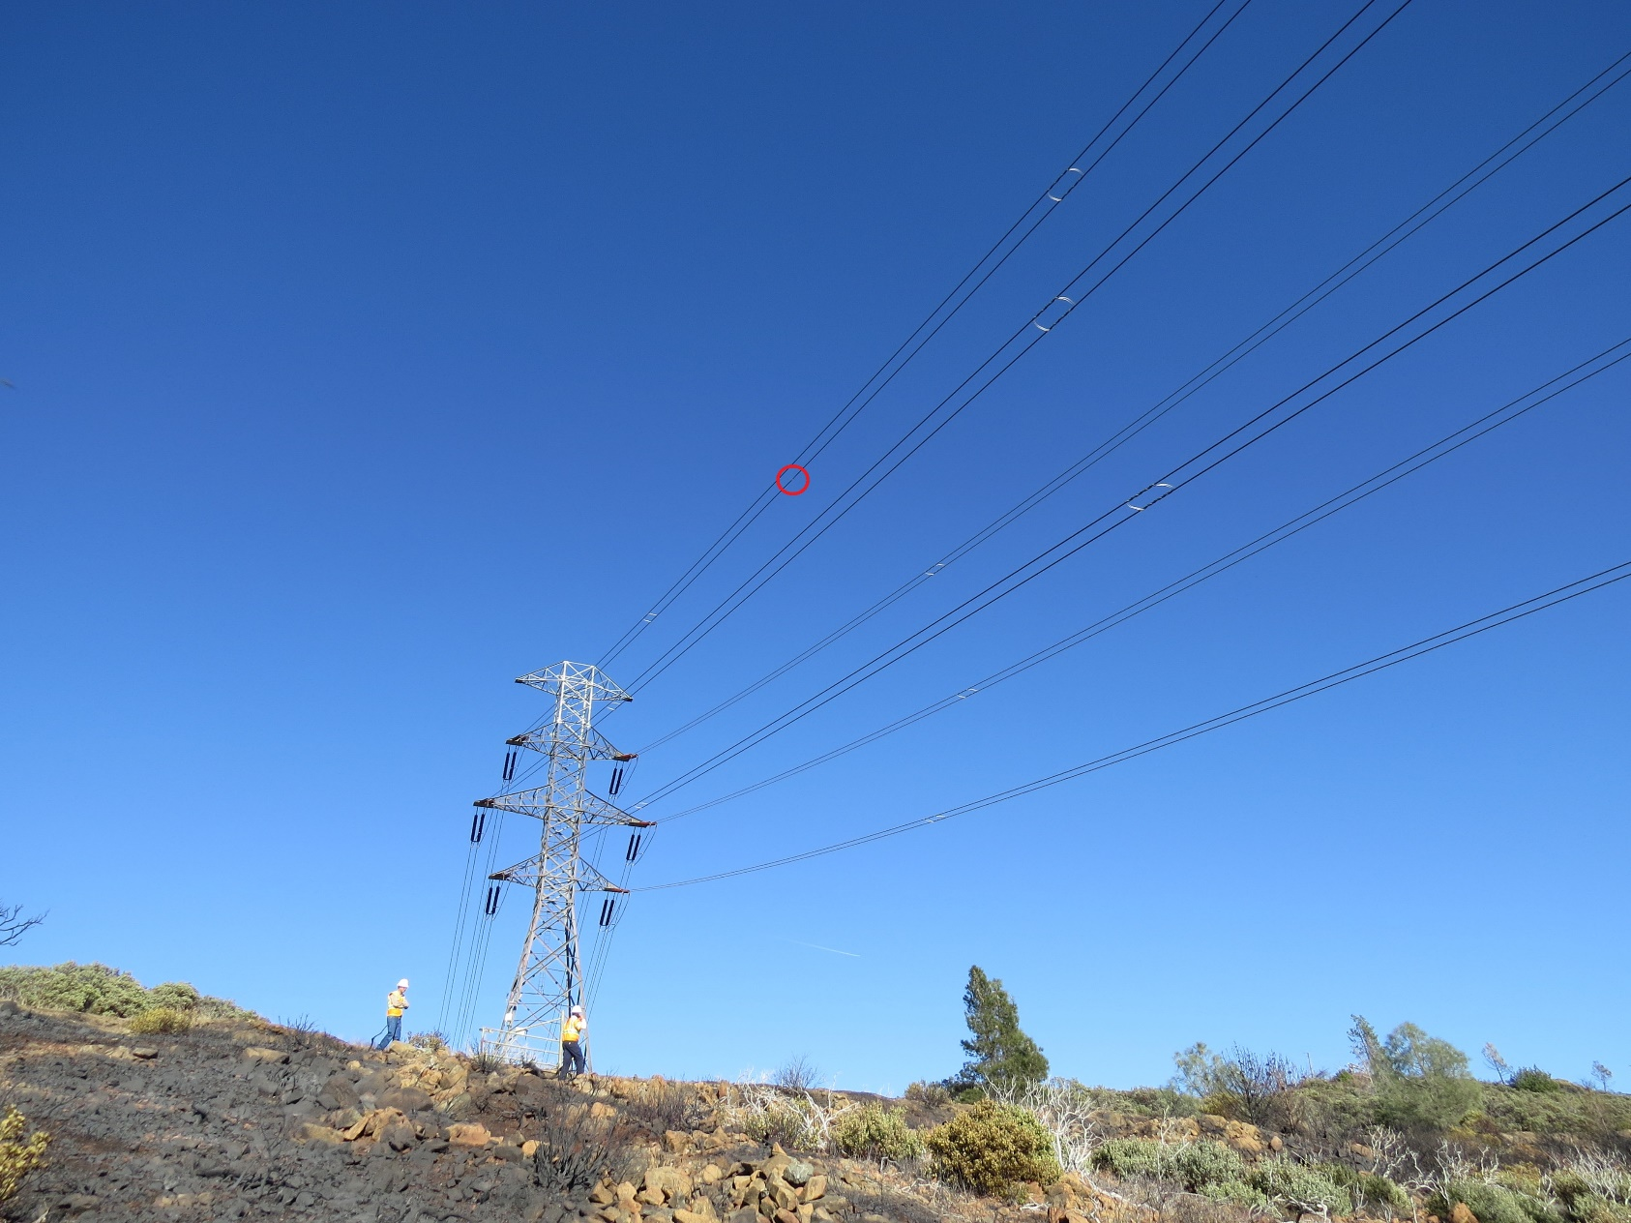
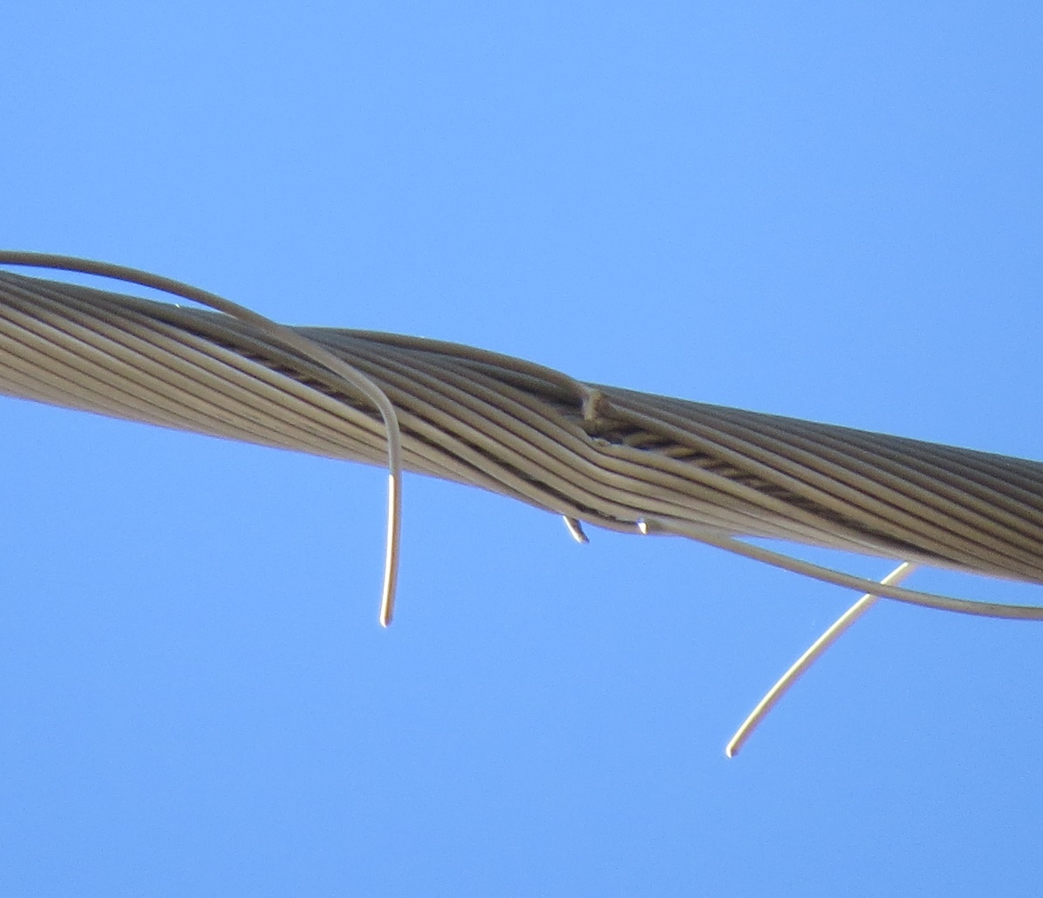
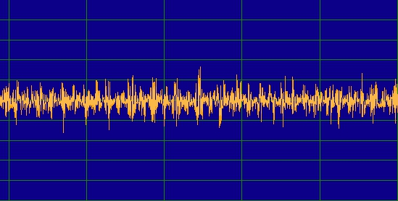
Kincade Fire Transmission Inspection Project
Location : Geysers 12-Fulton 3/16 between 3/17
/ Conductor- Damaged / PL - 2
Corona Discharge
(Ultrasound)

Slide 4
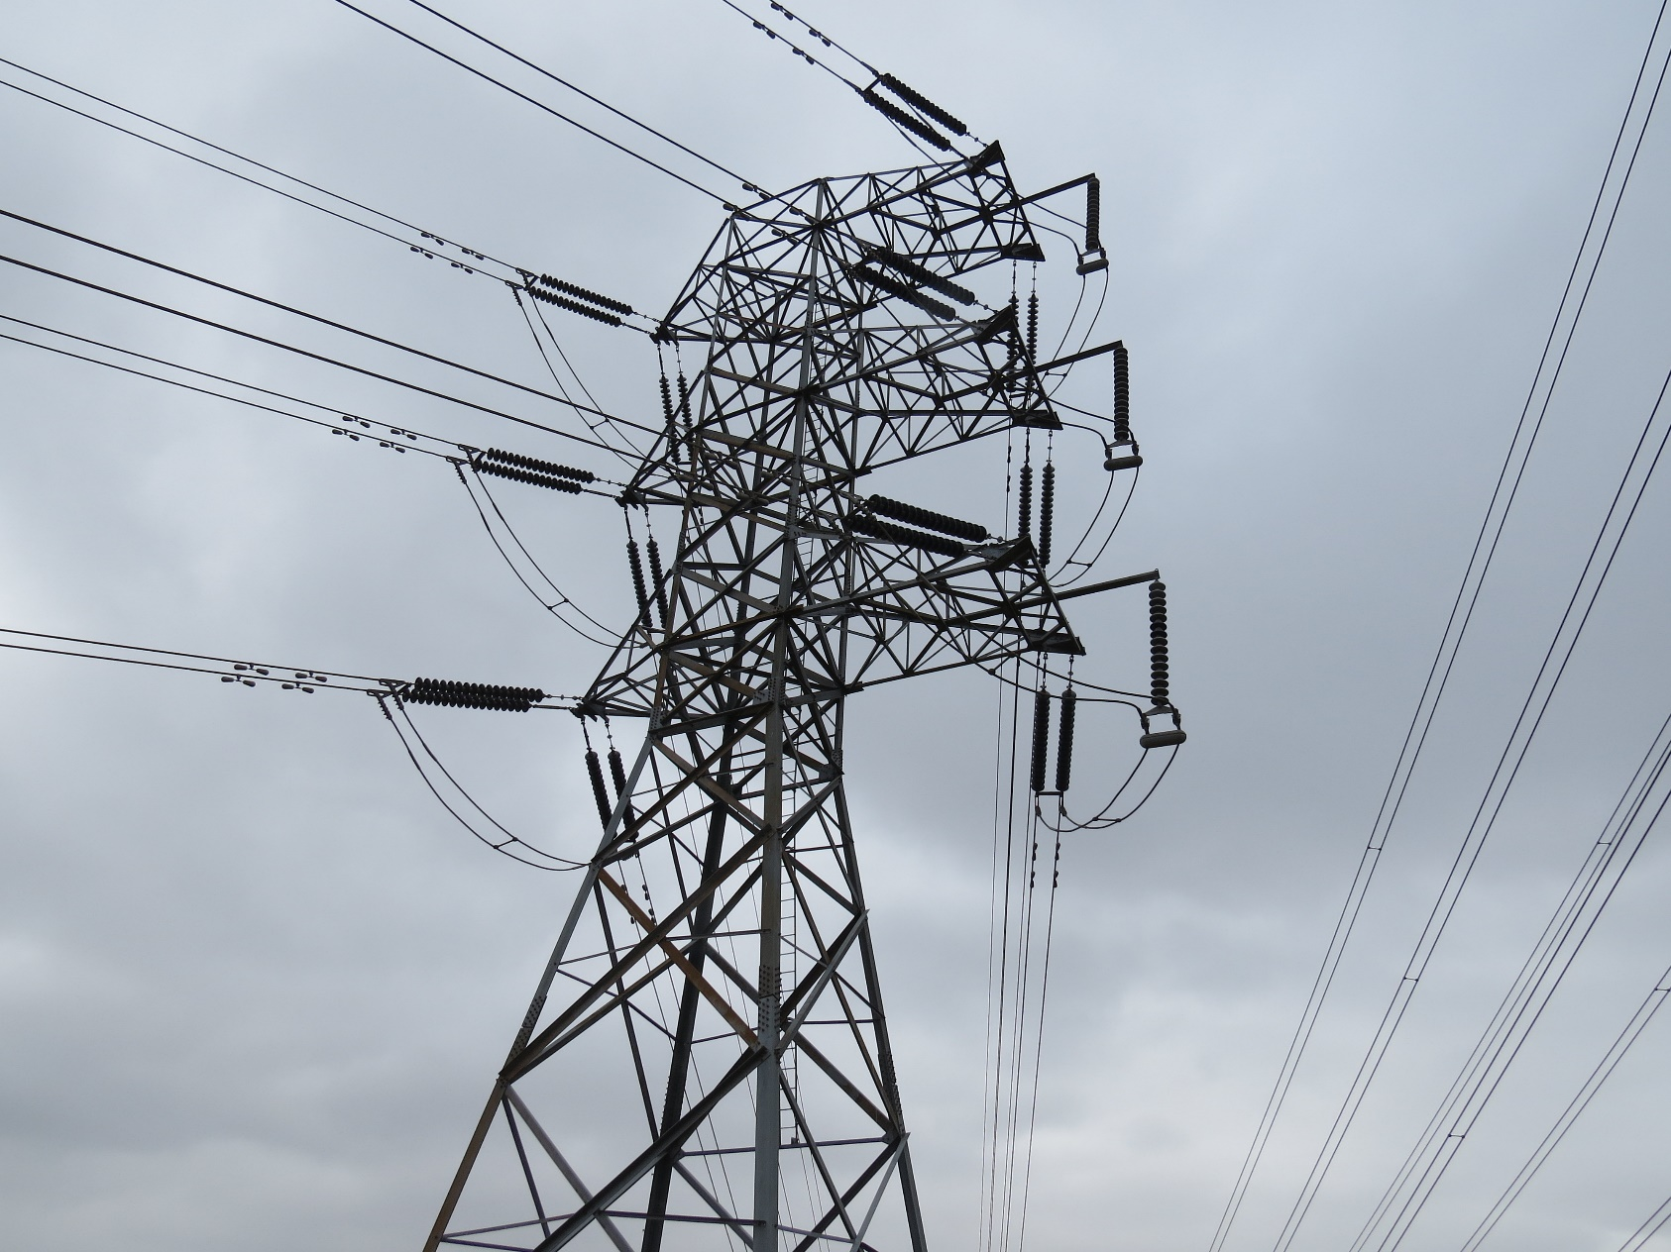
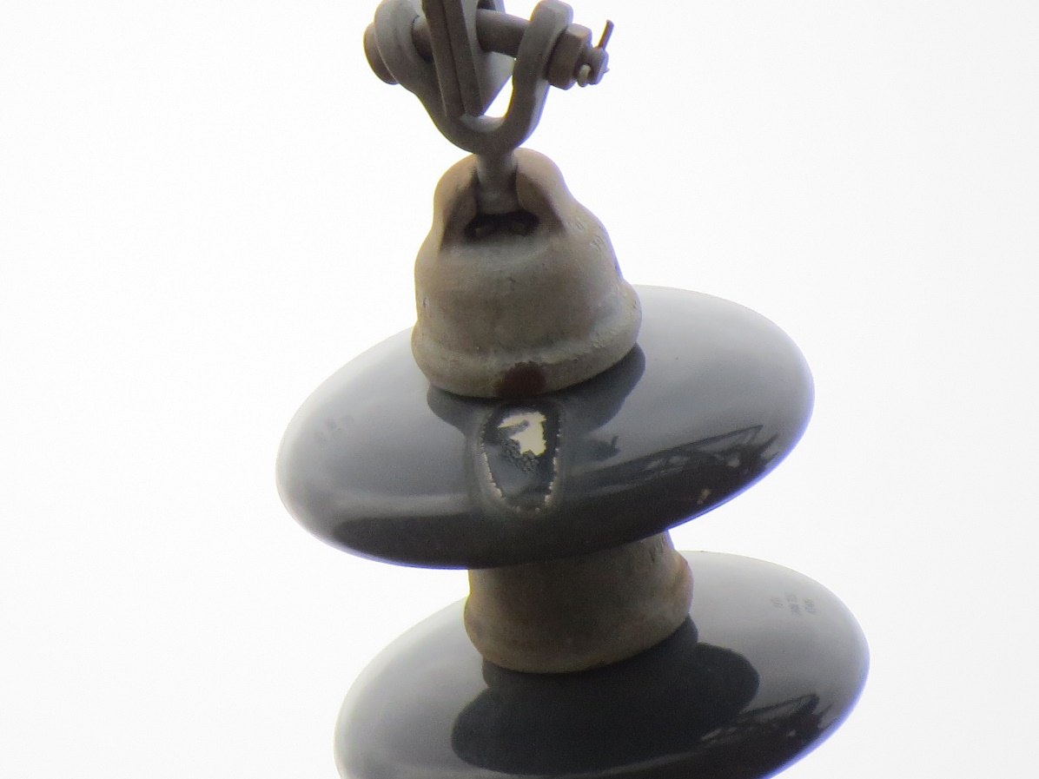
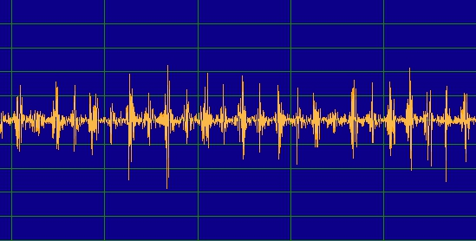
Kincade Fire Transmission Inspection Project
Location : Geysers 12-Fulton 17/70
/ Insulator- Flashover / PL - 3
Corona Discharge
(Ultrasound)

Slide 5
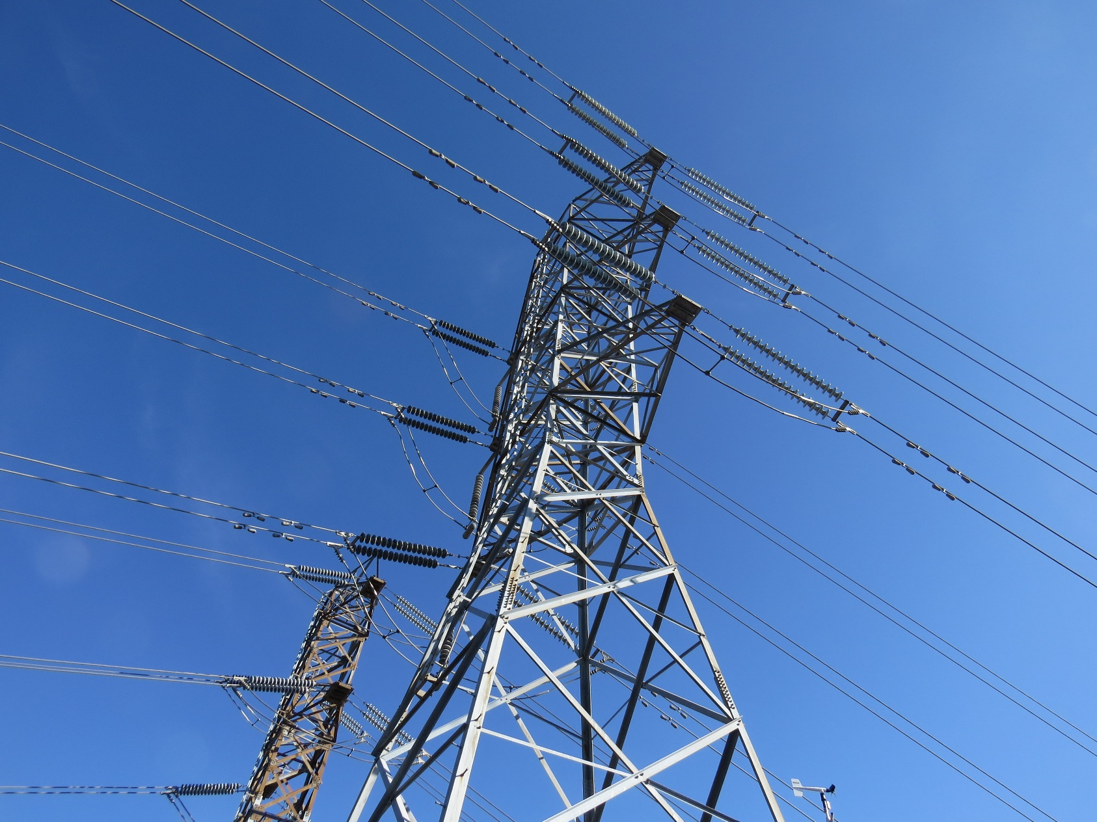
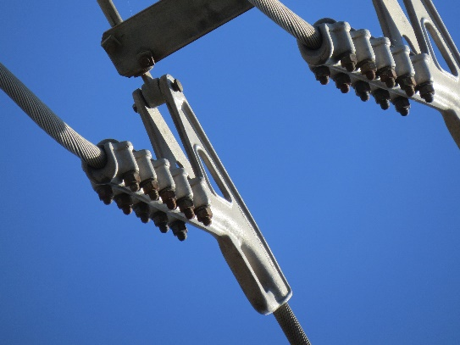
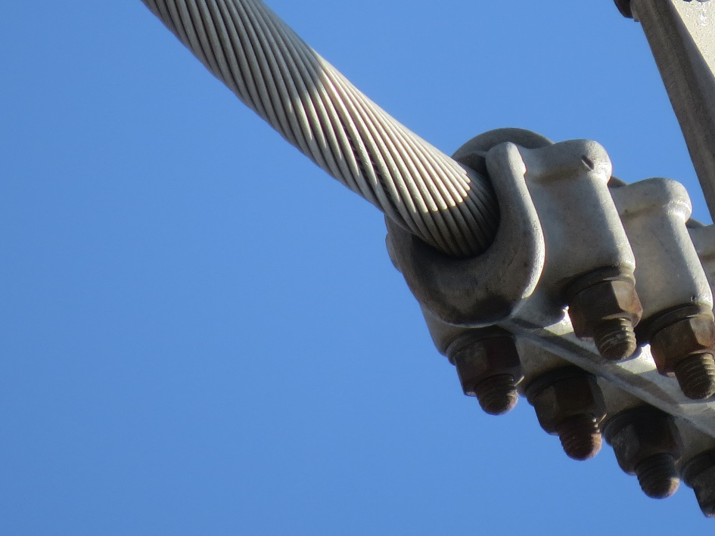
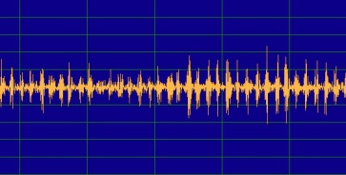
Kincade Fire Transmission Inspection Project
Location : Geysers 12-Fulton 9/40
/ Clamp – No visual defects / PL - 5
Corona Discharge
(Ultrasound)

Slide 6
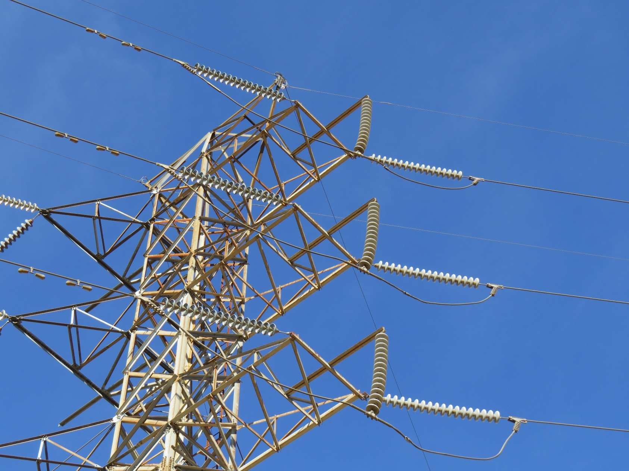
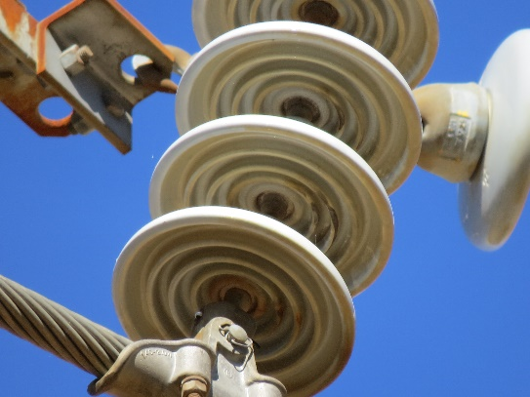
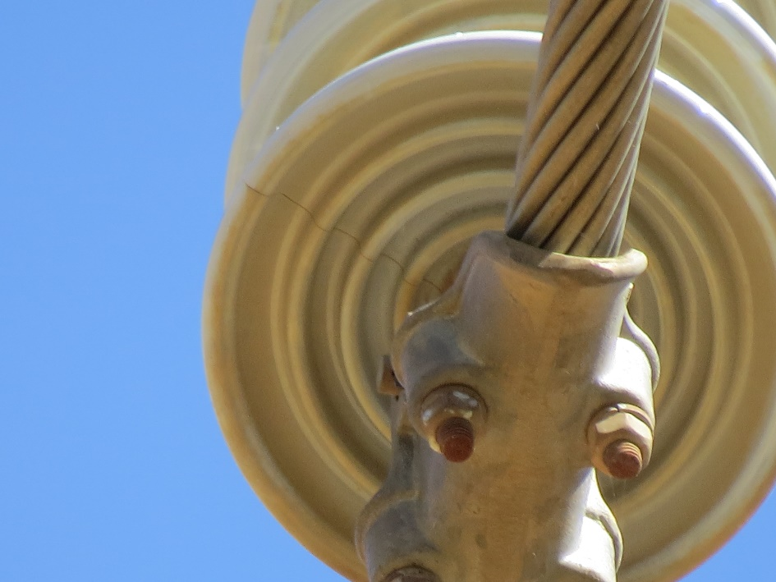
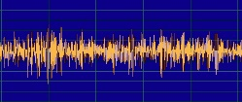
Kincade Fire Transmission Inspection Project
Location : Geysers 27-Fulton 1/7
/ Insulator - Cracked / PL - 2
Corona Discharge
(Ultrasound)

Slide 7
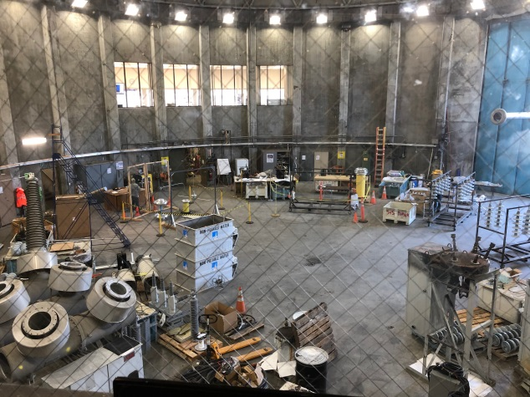
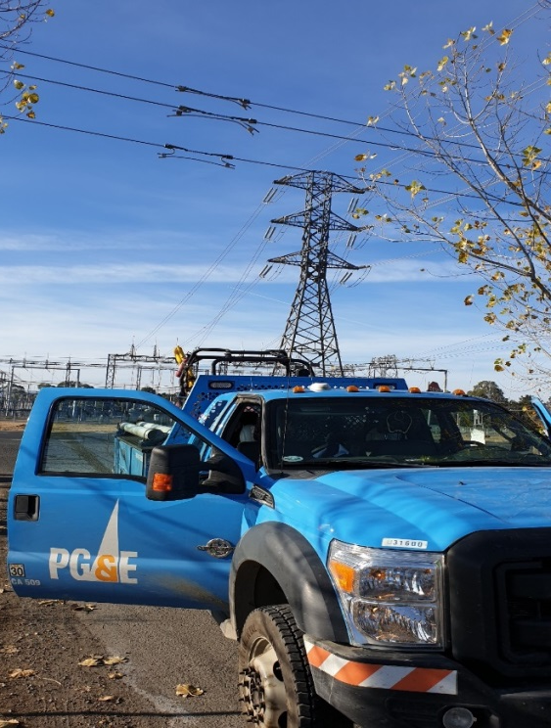
Distribution Inspection Project
Summary
Date : 03.04 ~ 03.16.2020
Area : Santa Rosa, CA
A total of 3400 structure were acoustically inspected
159 Defects were found

Slide 8
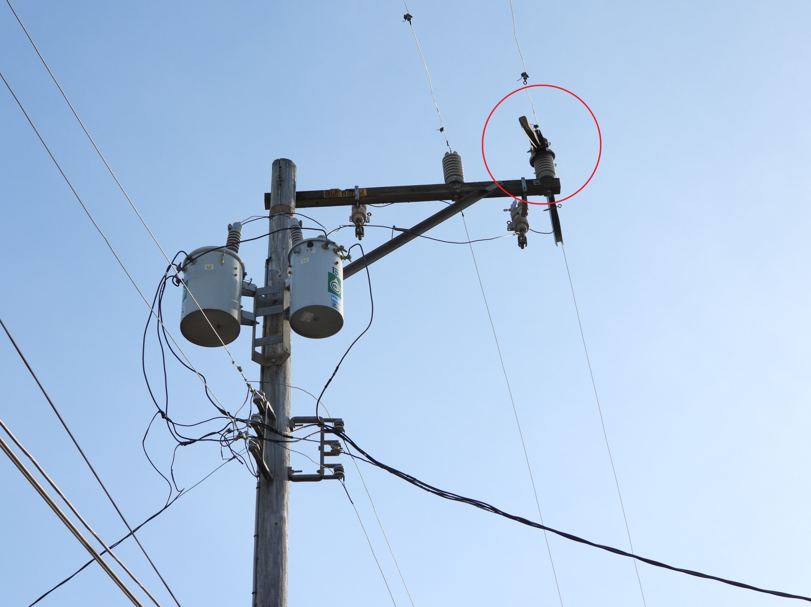
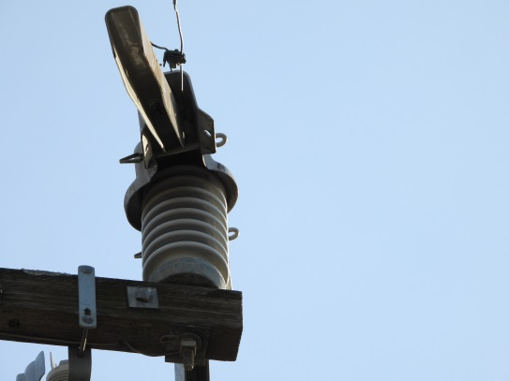
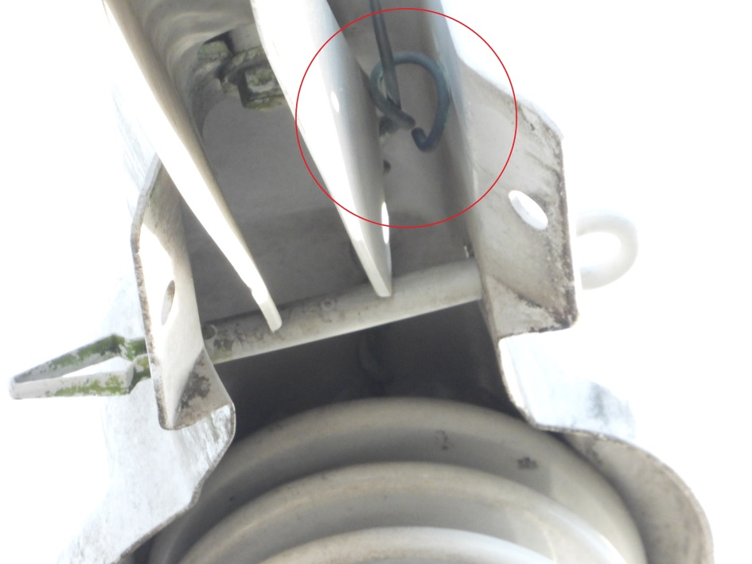
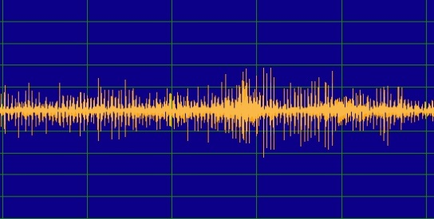
Distribution Inspection Project
Location : Castroville 2013
/ Conductor – Erosion/Arcing / PL - 1
Corona Discharge
(Ultrasound)

Slide 9
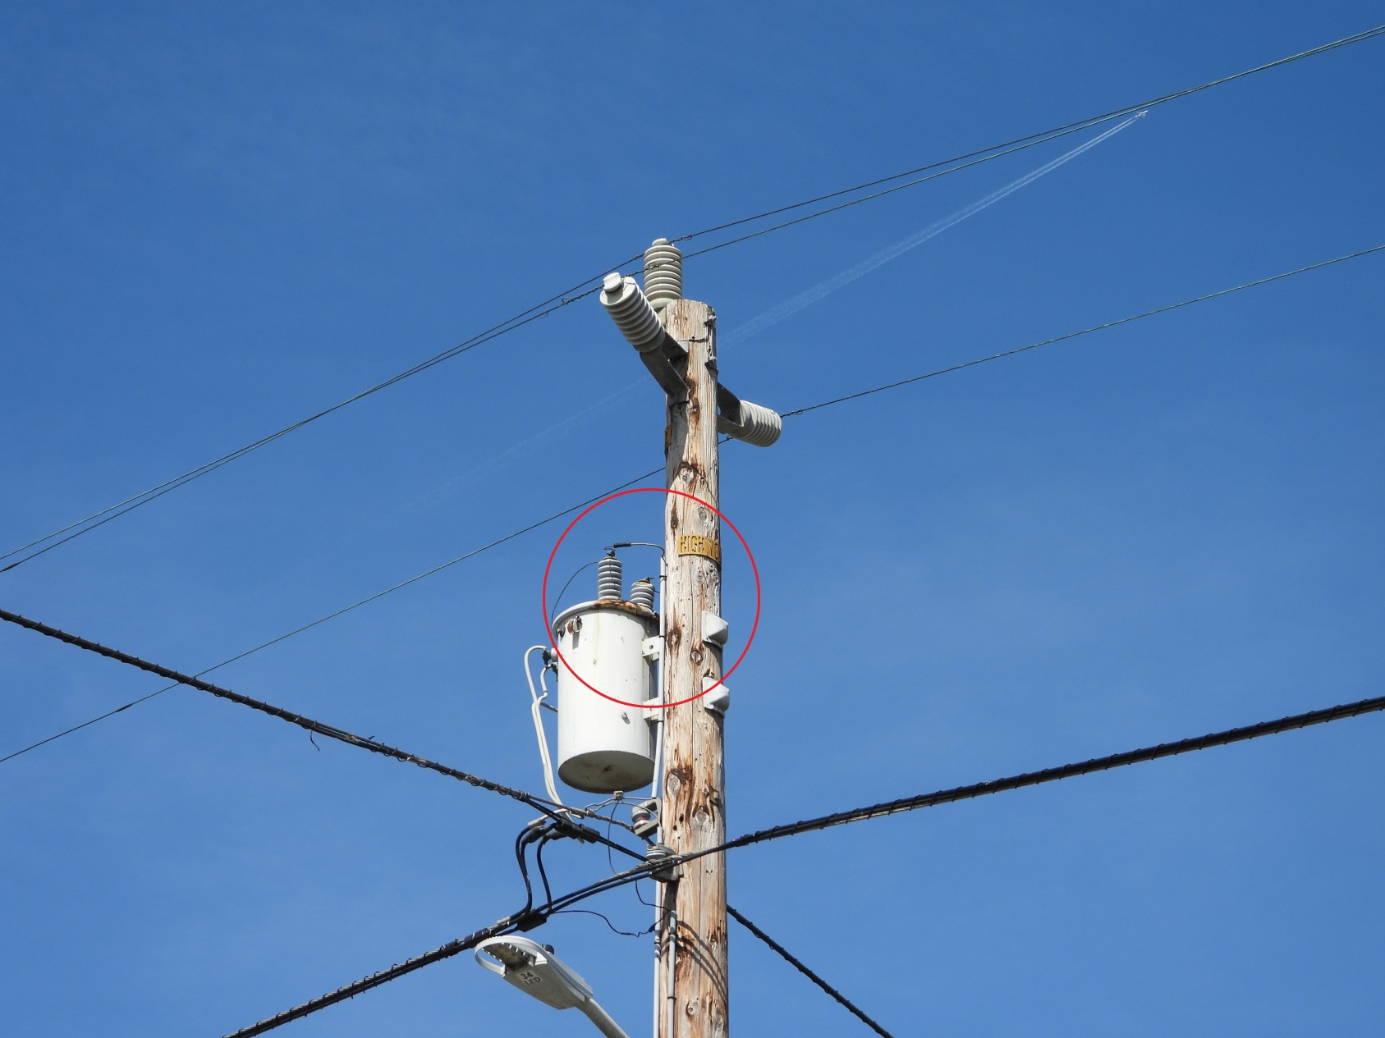
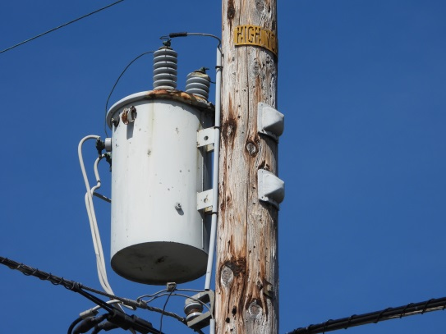
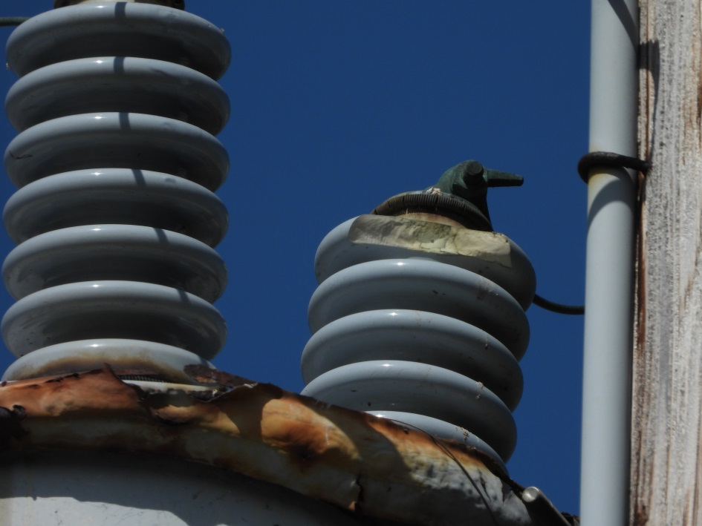
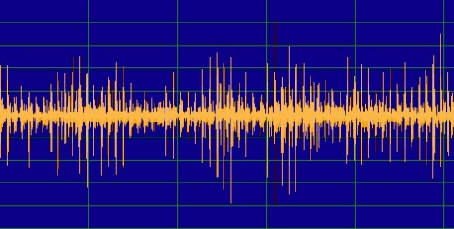
Distriution Inspection Project
Location : Castroville 2013 / 64-11500
/ Transformer Bushing – Damaged, Rusted / PL - 1
Corona Discharge
(Ultrasound)

Slide 10
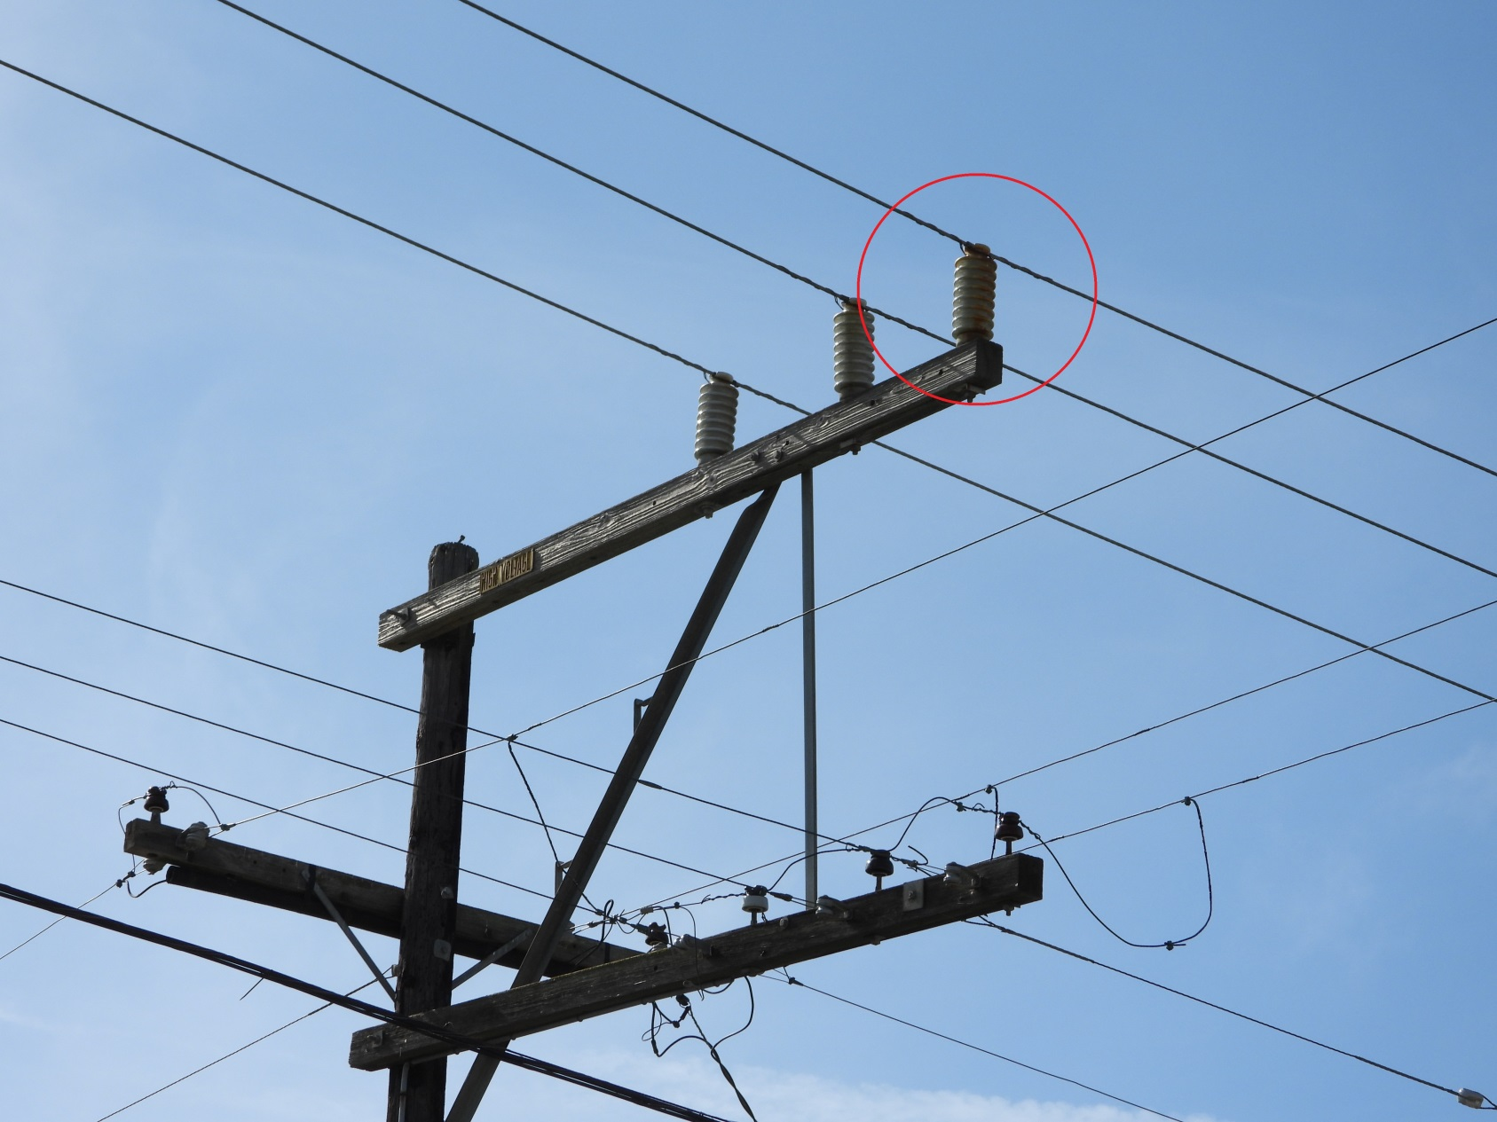
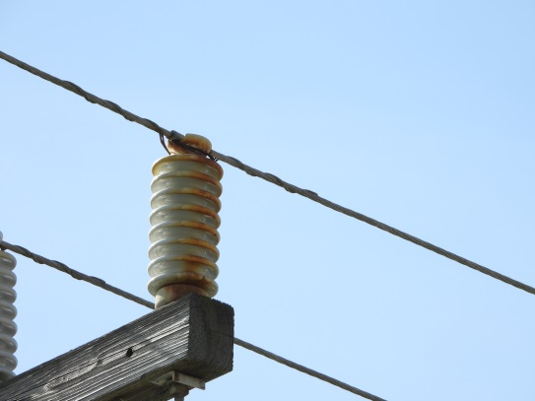
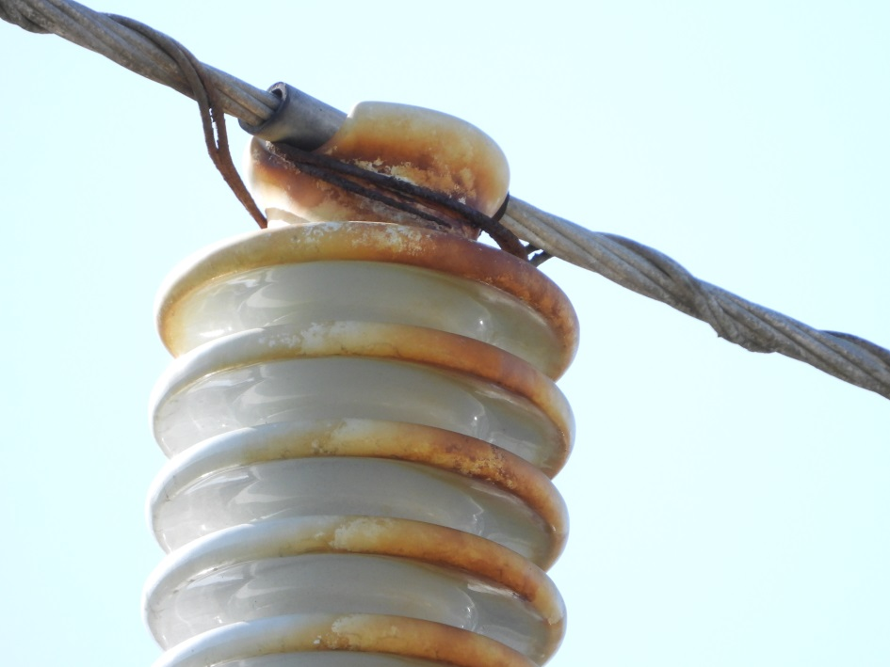
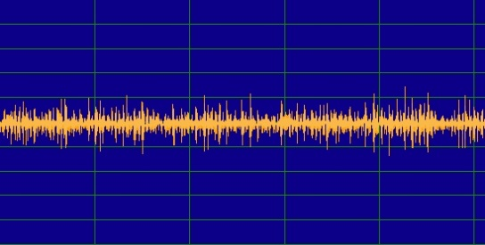
Distribution Inspection Project
Location : Castroville 2013
/ LP Insulator, Conductor – Corrosion, Erosion / PL - 3
Corona Discharge
(Ultrasound)

Slide 11
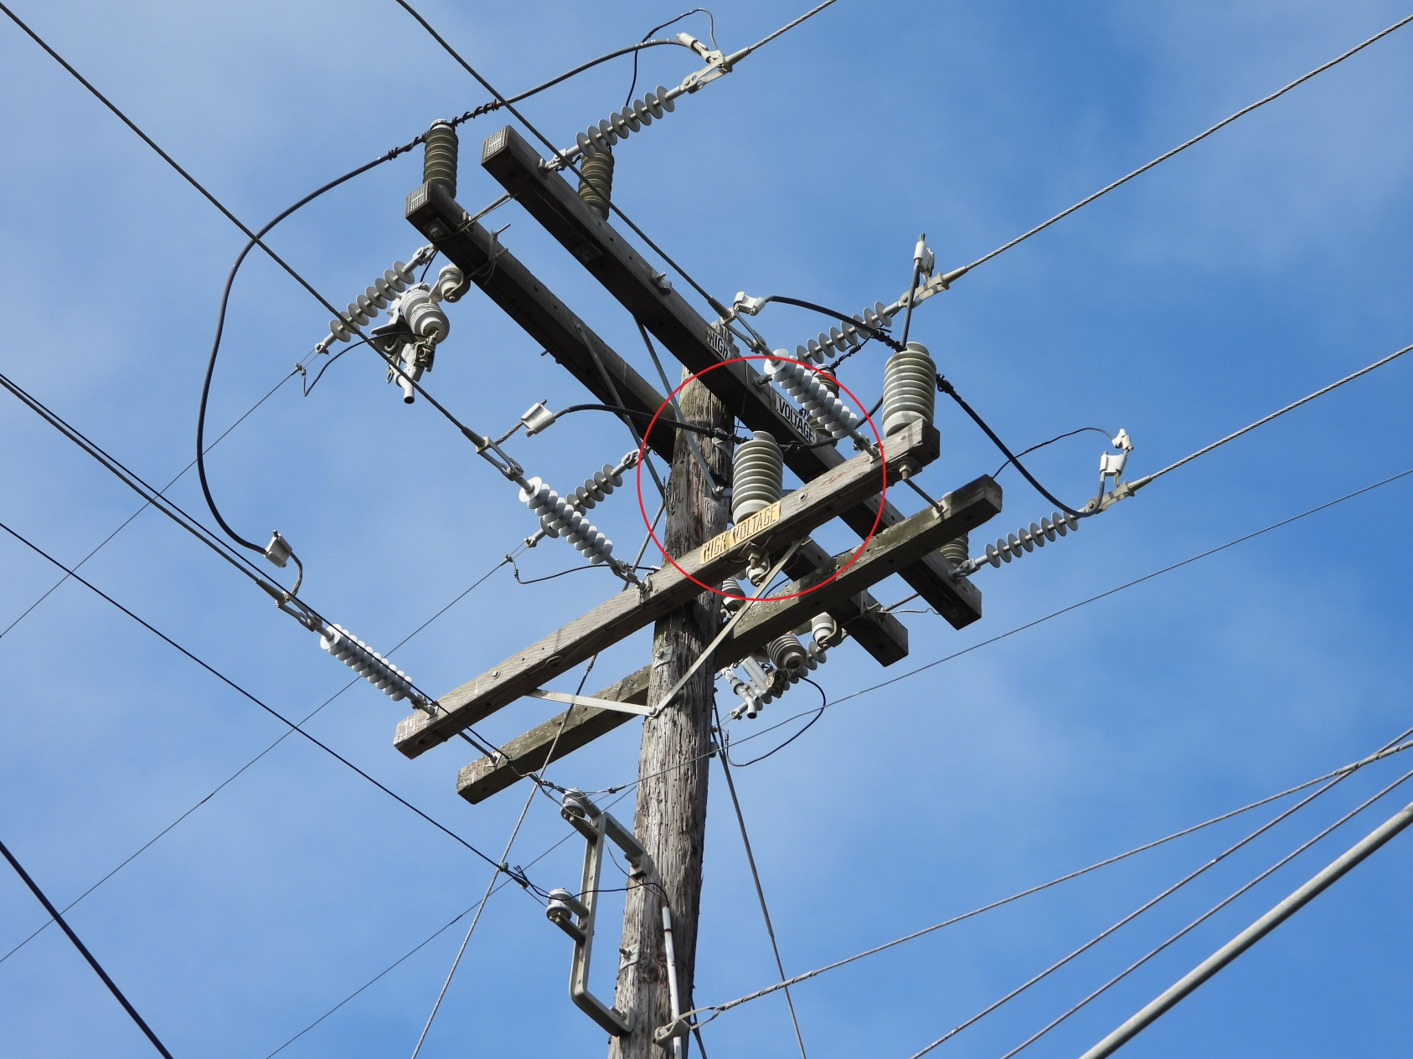
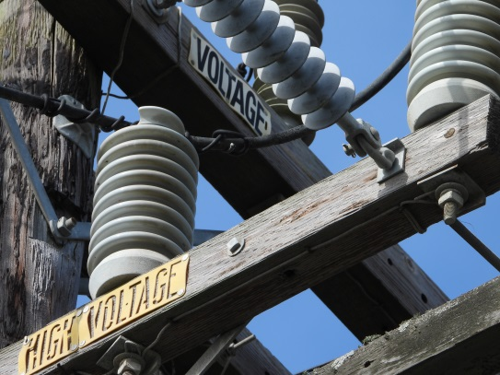
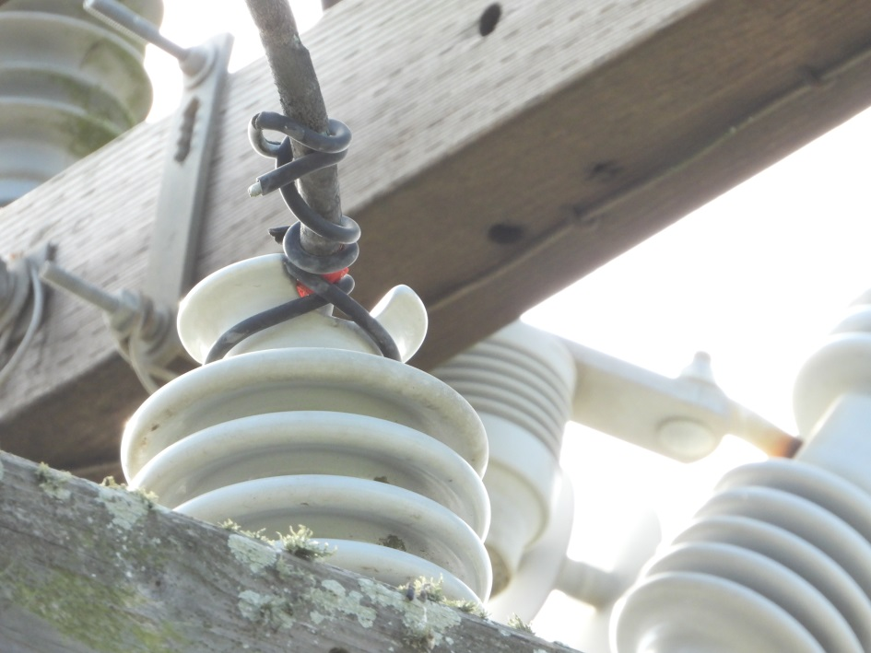
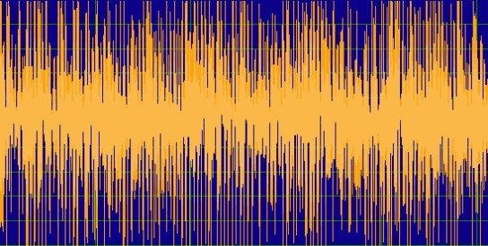
Distribution Inspection Project
Location : Castroville 2013 / 42-11381
/ Conductor – Erosion/Arcing / PL - 1
Corona Discharge
(Ultrasound)

Slide 12
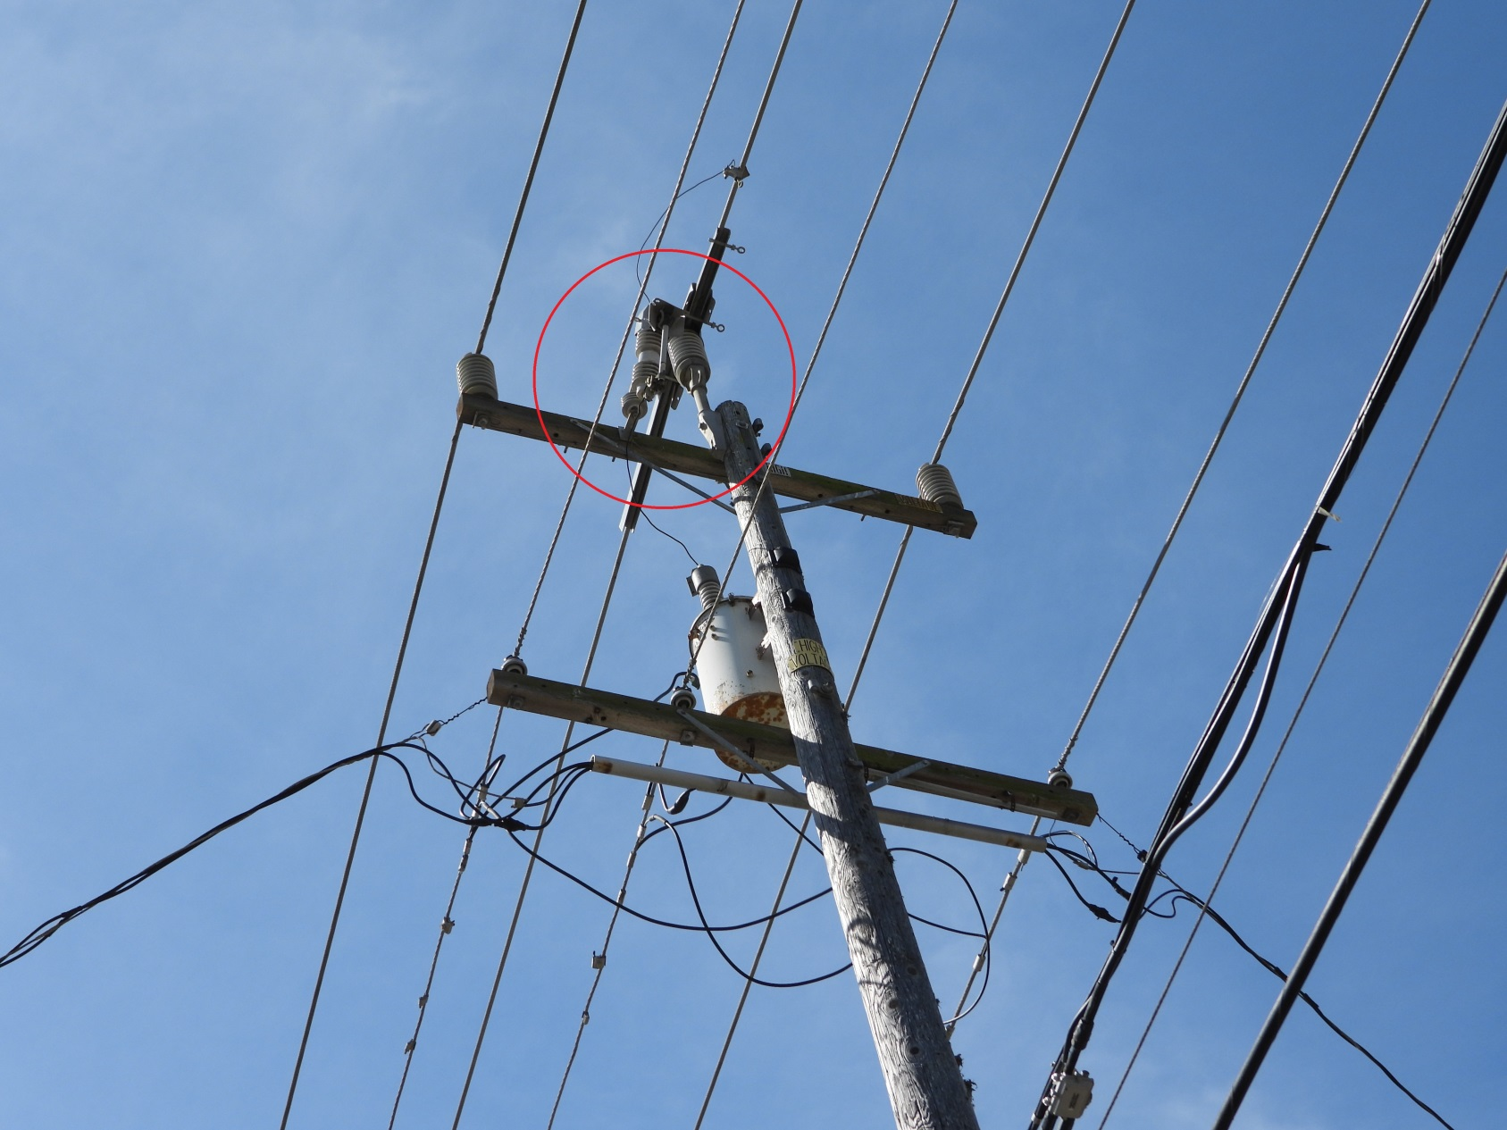
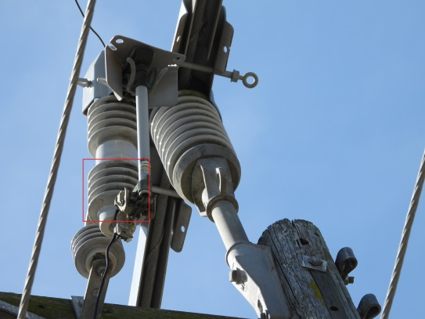
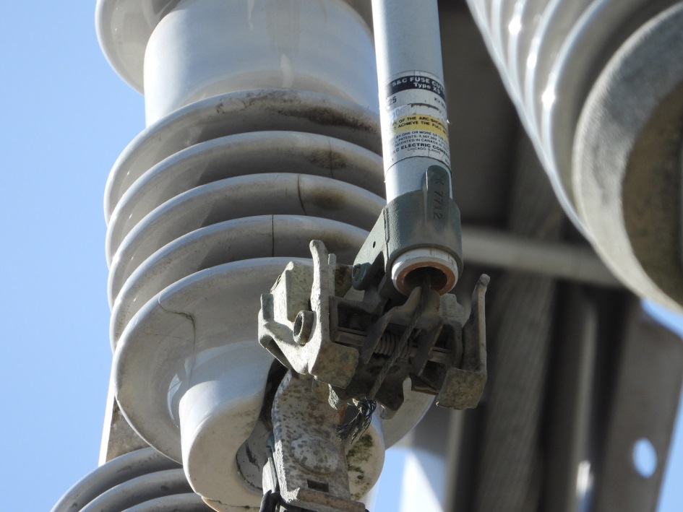
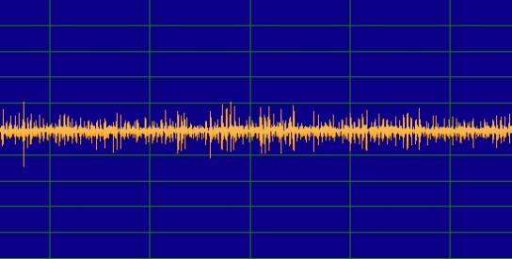
Distribution Inspection Project
Location : Castroville 2013 11341
/ C.O.S – Cracked / PL - 1
Corona Discharge
(Ultrasound)

Slide 13
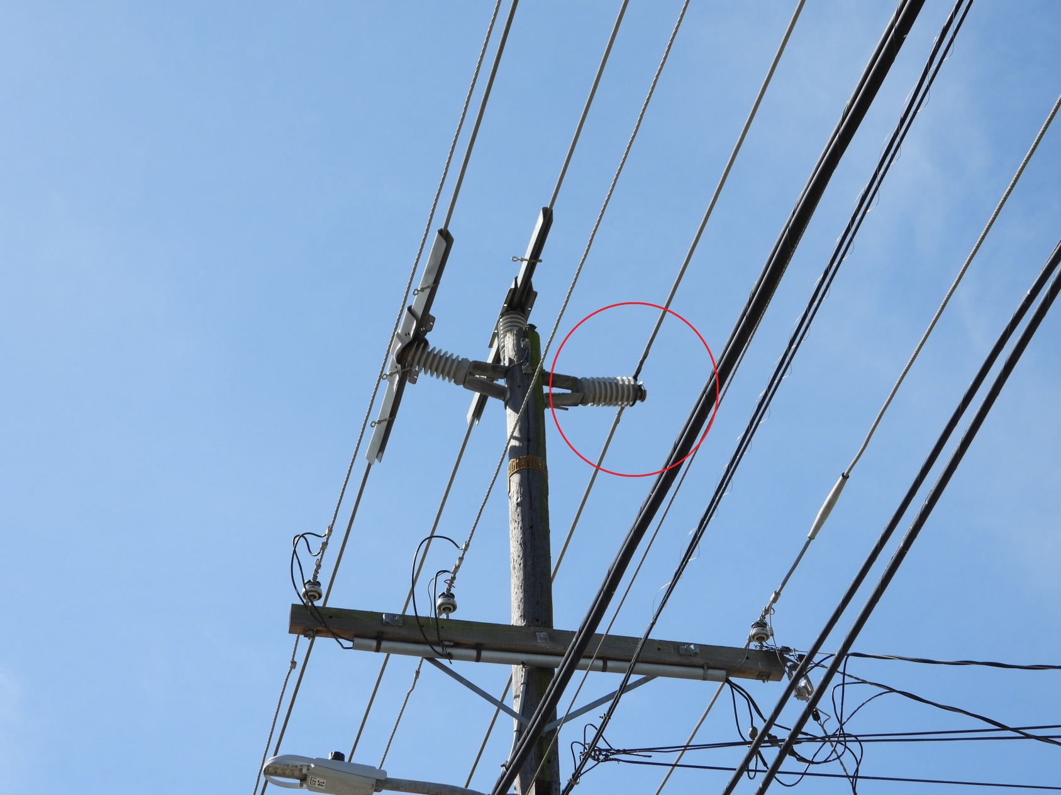
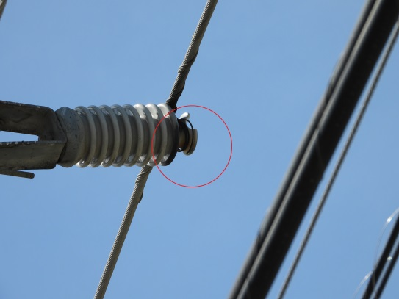
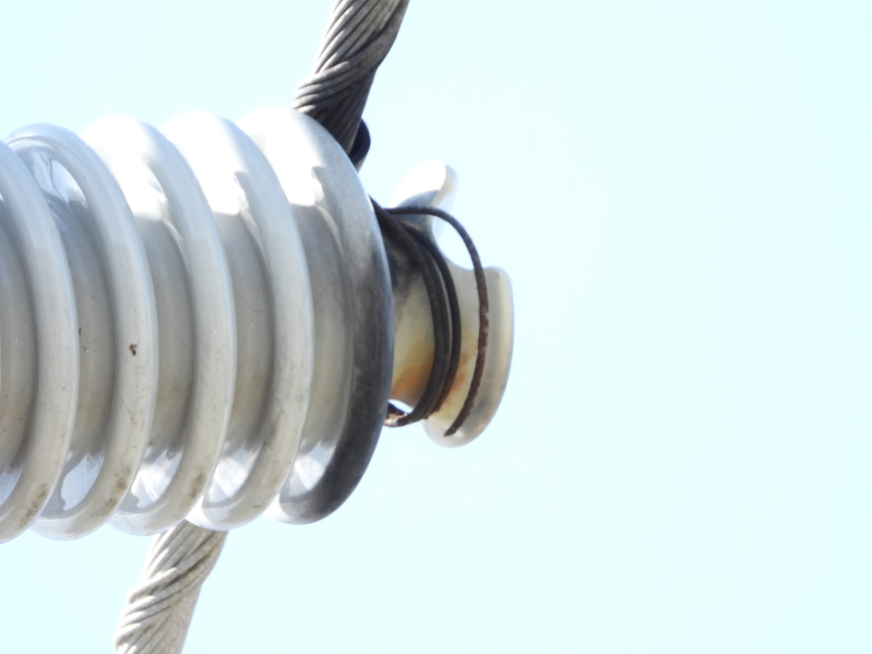
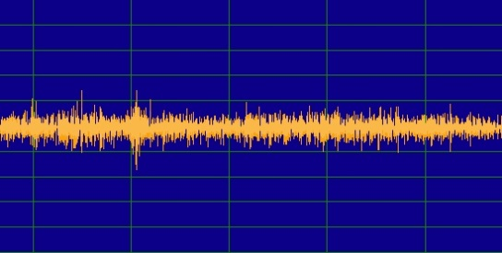
Distribution Inspection Project
Location : Castroville 2013
/ Conductor – Flashover / PL - 1
Corona Discharge
(Ultrasound)

Slide 14
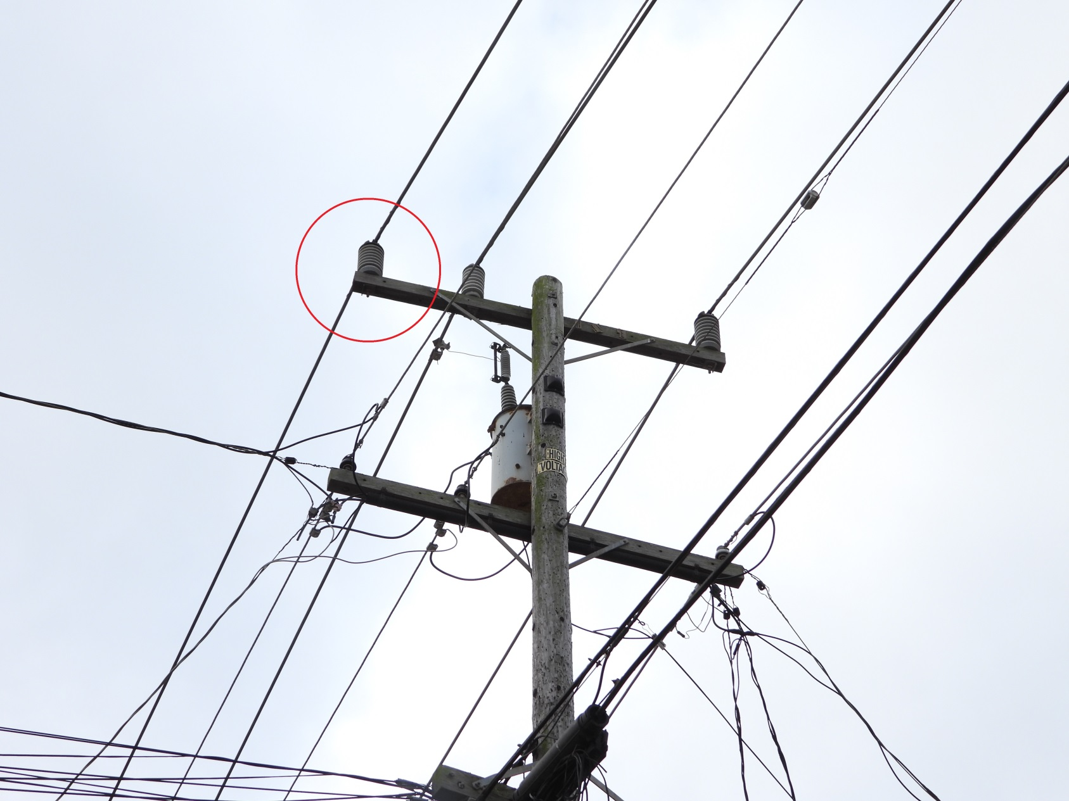
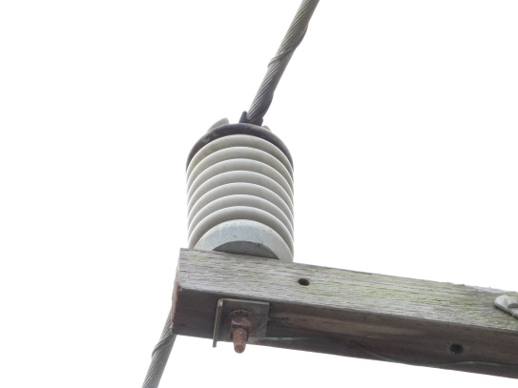
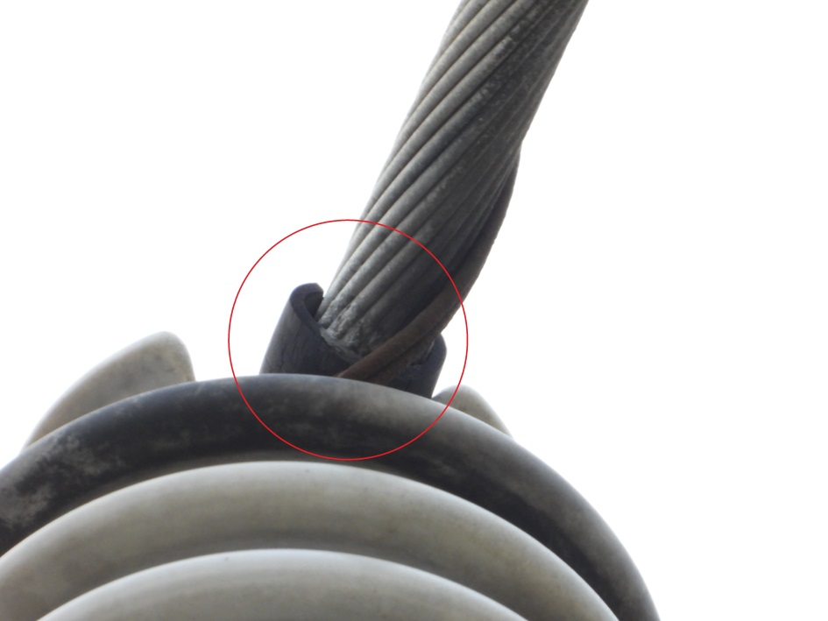
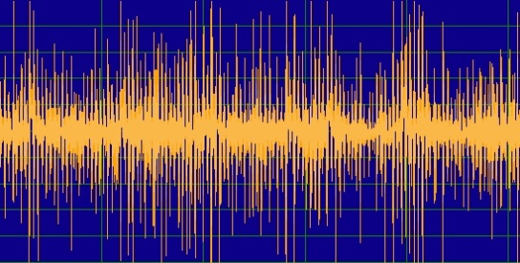
Distribution Inspection Project
Location : Castroville 2013
/ Conductor – Erosion / PL - 1
Corona Discharge
(Ultrasound)

Slide 15
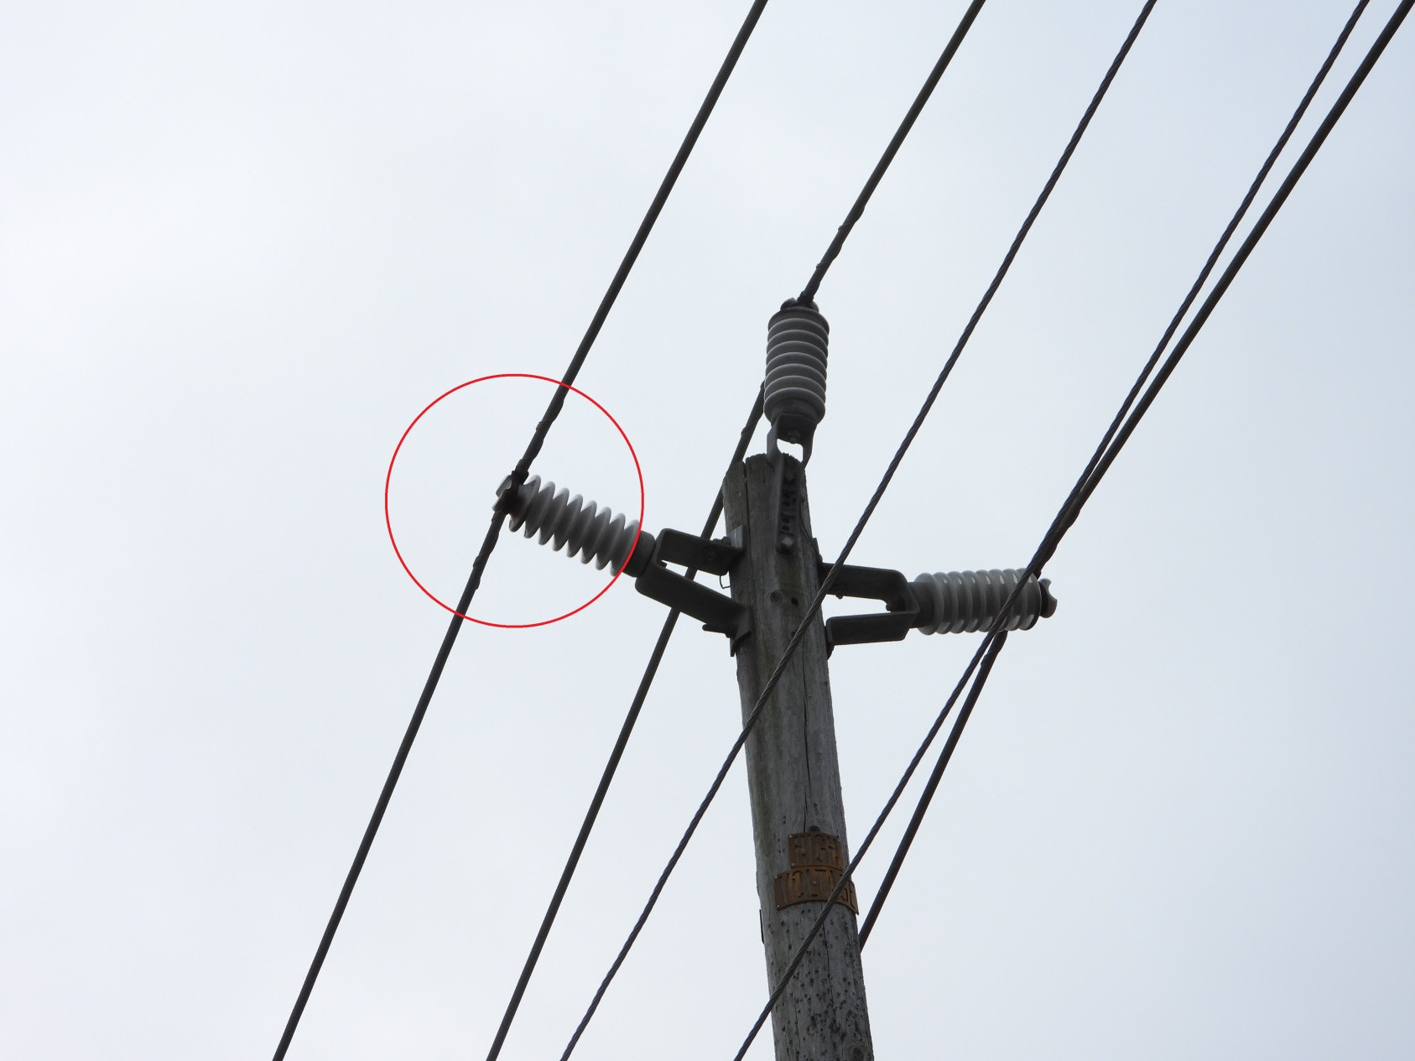
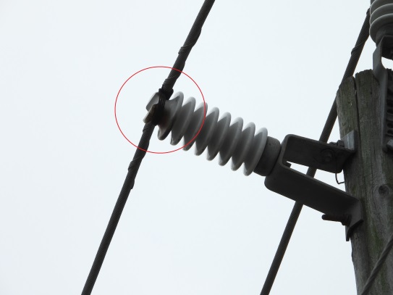
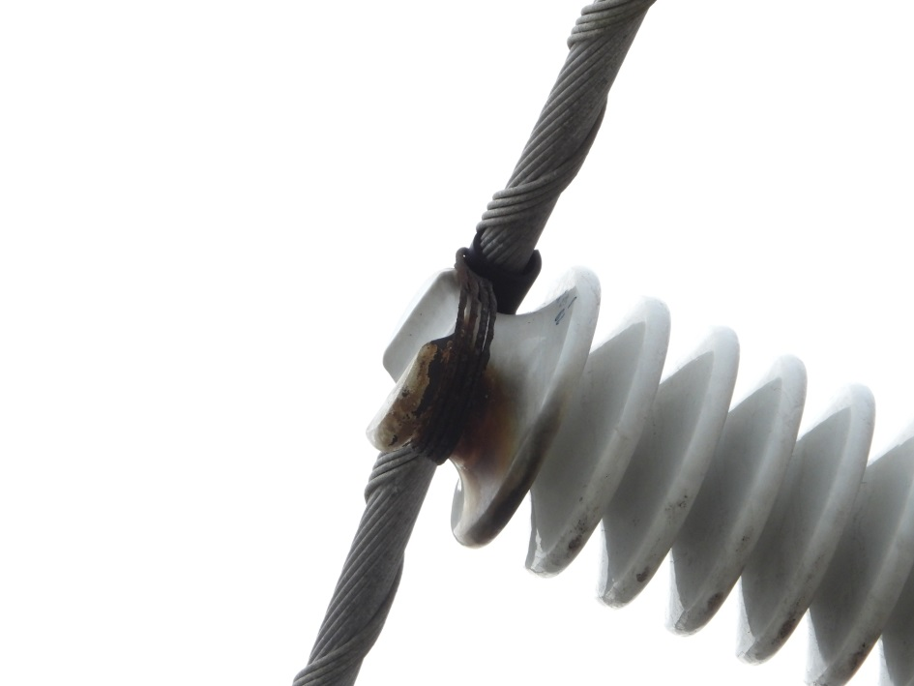
Distribution Inspection Project
Location : Castroville 2013
/ Conductor – Corrosion/Flashover / PL - 1
Corona Discharge
(Ultrasound)

Slide 16
Distribution Inspection Project
Location : Castroville 2013
/ LP Insulator – Carbonization, Flashover / PL - 2
Corona Discharge
(Ultrasound)

Slide 17
Distribution Inspection Project
Location : Castroville 2013
/ Suspension Insulator – Cracked / PL - 1
Corona Discharge
(Ultrasound)

Slide 18
Distribution Inspection Project
Location : Castroville 2013
/ LP Insulator – Cracked / PL - 1
Corona Discharge
(Ultrasound)

Slide 19
Distribution Inspection Project
Location : Green Velly 2013
/ Conductor – Erosion / PL - 1
Corona Discharge
(Ultrasound)

Slide 20
Distribution Inspection Project
Location : Green Velly 2013
/ Suspension Insulator – Damaged / PL - 1
Corona Discharge
(Ultrasound)

Slide 21
Distribution Inspection Project
Location : Green Velly 2013
/ Conductor – Erosion/Arcing / PL - 1
Corona Discharge
(Ultrasound)

Slide 22
Distribution Inspection Project
Location : Green Velly 2013
/ Conductor – Erosion / PL - 1
Corona Discharge
(Ultrasound)

Slide 23
Distribution Inspection Project
Location : Green Velly 2013
/ Conductor – Erosion / PL - 1
Corona Discharge
(Ultrasound)

Slide 24
Distribution Inspection Project
Location : Green Velly 2013
/ Conductor – Broken tie wire / PL - 1
Corona Discharge
(Ultrasound)

Slide 25
Distribution Inspection Project
Location : Green Velly 2013 9961-148
/ Clamp – Arcing / PL - 1
Corona Discharge
(Ultrasound)

Slide 26
Distribution Inspection Project
Location : Green Velly 2013
/ LP Insulator, Tie wire – Flashover / PL - 1
Corona Discharge
(Ultrasound)

Slide 27
Distribution Inspection Project
Location : Big basin 1101
/ Conductor – Foreign object / PL - 5
Corona Discharge
(Ultrasound)

Slide 28
Distribution Inspection Project
Location : Big basin 1101
/ Conductor – Vegetation / PL - 5
Corona Discharge
(Ultrasound)

Slide 29
Distribution Inspection Project
Location : WEST POINT 1101
/ Conductor – Damaged / PL - 1
Corona Discharge
(Ultrasound)

Slide 30
Distribution Inspection Project
Location : WEST POINT 1101
/ Conductor – Damaged / PL - 1
Corona Discharge
(Ultrasound)

Slide 31
Distribution Inspection Project
Location : Stanislaus 1720 R1739
/ Conductor – Vegetation / PL - 5
Corona Discharge
(Ultrasound)

Slide 32
Distribution Inspection Project
Location : Stanislaus 1720 L5495
/ Conductor – Vegetation / PL - 5
Corona Discharge
(Ultrasound)

Slide 33
Distribution Inspection Project
Location : Stanislaus 1720 L5495
/ Transformer Bushing – Arcing/Vegetation / PL - 1
Corona Discharge
(Ultrasound)

Slide 34
Thank You
CONTACT US:
WWW.INSPECO.NET
Email : inspeco@insepco.co.kr

